Slide 1




CIT 596 MODULE 10.1
Optimal Static Binary Search Trees
Sampath Kannan

Slide 2



OPTIMAL STATIC BINARY SEARCH TREES
Input:
$n$ keys (in sorted order)
$k_{1}< k_{2}<. . . <k_{n}$
Along with probability of each key being accessed, $p_{1}< p_{2}<. .. <p_{n}$
Goal: build a binary search tree (BST) that minimizes average access time
Minimize $\sum_{i=0}^{n−1}{\left(P_{i}\right)}(depth\left(k_{i}\right)+1)$
P(access) access time
Called “static” because we do not insert or delete keys, just search for them

Slide 3
EXAMPLE
key | a | b | c | d | e | f | g | h | i | j
P(access) | 0.15 | 0.05 | 0.08 | 0.1 | 0.2 | 0.05 | 0.1 | 0.07 | 0.15 | 0.05
0.2
e
0.08
0.15
c
i
0.15
0.1
0.1
0.05
a
d
g
j
0.05
0.05
0.07
b
f
h
Average
Access
Time
=
0.2*1
+
0.08*2
+
0.15*2
+
0.15*3
+
0.1*3
+
0.1*3
+
0.05*3
+
0.05*4
+
0.05*4
+
0.07*4 = 2.54

Slide 4

OPTIMAL STATIC BST
Question for top-level decision : Which element to make the root?
If we make $k_{i}$ the root:
Search tree property
The left subtree must consist of $k_{1}, . . . , k_{i−1}$
The right subtree must consist of $k_{i+1}, . . . , k_{n}$
Left and right subtrees should also be optimal BSTs for their elements

Slide 5

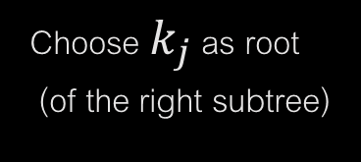


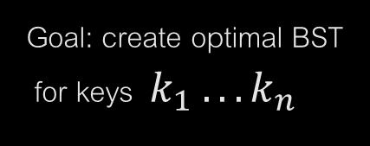



OPTIMAL STATIC BST
What subproblems might need to be solved?
$k_{1}$ $k_{n}$
$$k_{i}$$
$$k_{j}$$
Compute left subtree (keys $k_{i+1} . . .k_{j−1}$)
Compute right subtree (using keys $k_{i+1} . . .k_{n}$)
Choose $k_{i}$ as root
Choose $k_{j}$ as root (of the right subtree)
Goal: create optimal BST for keys $k_{1} . . . k_{n}$

Slide 6

OPTIMAL STATIC BST
What subproblems might need to be solved?
Potentially one for each contiguous set of keys [$k_{i}. . . k_{j}$]
How many are there?
Each contiguous set is defined by choosing two keys from our set (smallest and largest key in the interval)
$\left(\begin{matrix}n \\ 2\end{matrix}\right)=\frac{n(n−1)}{2} O(n^{2})$

Slide 7
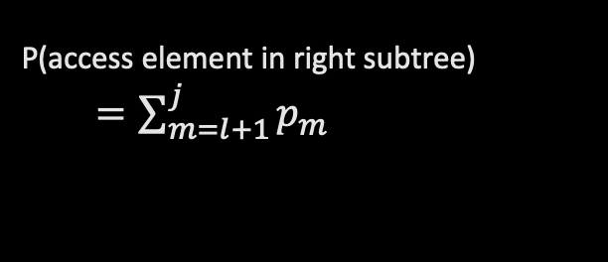
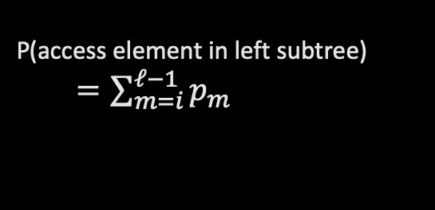




OPTIMAL STATIC BST: RECURRENCE
Can we define a recurrence for this problem?
$T(i, j)$= average access time of an optimal BST for the keys $k_{i}, k_{i+1} . . ., k_{j}$
For any $ℓ∈\left[i,j\right],$if we choose $k_{ℓ}$ as root:
Search times for every element in both subtrees increases by 1
$$k_{ℓ}$$
P(access element in left subtree)
$=\sum_{m=i}^{ℓ−1}{p_{m}}$
P(access element in right subtree)
$=\sum_{m=l+1}^{j}{p_{m}}$
$$k_{i}…k_{ℓ−1}$$
$$k_{ℓ+1}…k_{j}$$

Slide 8

OPTIMAL STATIC BST: RECURRENCE
Can we define a recurrence for this problem?
$T (i, j)$= average access time of an optimal BST for the keys $k_{i}, k_{i+1} . . ., k_{j}$
$T(i, j)$
=${ Min}_{i≤ℓ≤j}[T\left(i, ℓ−1\right)+1∙\sum_{m=i}^{ℓ−1}{p_{m}+T\left(ℓ+1,j\right)+1∙\sum_{m=ℓ+1}^{j}{p_{m}+ 1∙p_{ℓ} }}]$
= ${ Min}_{i≤ℓ≤j}[T\left(i, ℓ−1\right)+ T\left(ℓ+1,j\right)+ \sum_{m=i}^{j}{p_{m } ]}$
Last term is independent of the choice of root index. Can precompute $\sum_{m=i}^{j}{p_{m} }$for all $i≤j$

Slide 9

OPTIMAL STATIC BST: RUNNING TIME
We leave the pseudocode for the algorithm as an exercise.
Number of subproblems $O(n^{2})$
Time required to calculate subproblem (given previous subproblem solutions): $j − i ∈O\left(n\right)$
Total runtime: $O(n^{3})$

Slide 10
DYNAMIC PROGRAMMING: DESIGN
How do we design dynamic programming algorithms?
What is the top-level decision question?
There could be many possible questions.
Picking the right one is an art.
Once a top-level question is chosen, understand the number of subproblems.
Do we have optimal substructure i.e. do we want to solve the subproblems optimally for the overall optimum solution?
Write down a recurrence for solving a larger problem from smaller problems.
Next, design a recursive algorithm that solves the whole problem by considering each answer to the top-level question and by recursively solving the resulting subproblems.
Or, skip the previous step and design a bottom-up algorithm.

Slide 11
DYNAMIC PROGRAMMING: DESIGN
Design choice: whether to implement the algorithm “top-down” or “bottom-up”
Top-down: start at the top-level problem and recursively solve subproblems with memoization
Bottom-up: iteratively compute solutions to subproblems starting with the smallest subproblems.
Generally a little faster
Requires work to make sure subproblems are solved in the correct order
Basic algorithm only computes the cost of the solution.
Keeping track of the actual solution requires extra bookkeeping.

